Slide 1
M.Tech.(Data Science & Engineering) Introduction to Statistical Methods
Team ISM

Slide 2
Session No 2
Axioms of Probability, Probability basics, mutually exclusive and independent events,
(Session 2: 19th/20th Nov 2022)

Slide 3
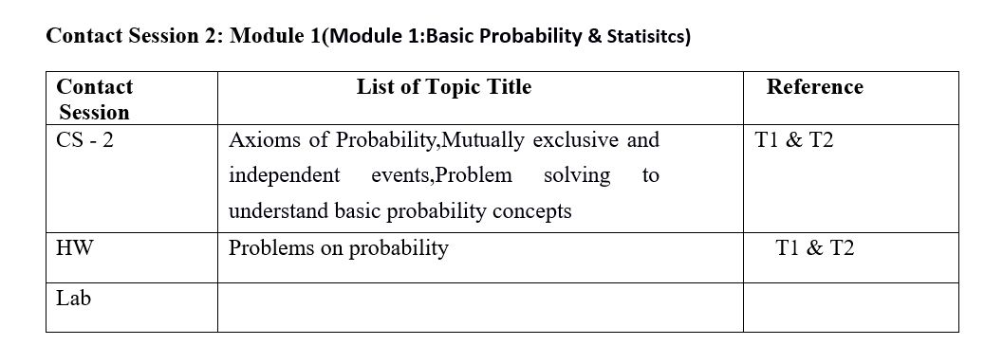
Contact Session 2

Slide 4
Agenda
Experiments, assignment of probabilities
Events and their probability
Some basic relationships of probability
Basic problem solving

Slide 5
RECALL: Random Experiment
Term "random experiment" is used to describe any action whose outcome is not known in advance. Here are some examples of experiments dealing with statistical data:
Tossing a coin
Counting how many times a certain word or a combination of words appears in the text of the “King Lear” or in a text of Confucius
counting occurrences of a certain combination of amino acids in a protein database.
pulling a card from the deck

Slide 6
Sample spaces, sample sets and events
The sample space of a random experiment is a set S that includes all possible outcomes of the experiment.
For example, if the experiment is to throw a die and record the outcome, the sample space is S = { 1,2,3,4,5,6}

Slide 7
Discrete sample spaces.
Continuous sample spaces

Slide 8
Discrete Random Variables
A discrete random variable is one which may take on only a countable number of distinct values such as 0,
1, 2, 3, 4,....
• Discrete random variables are usually (but not necessarily) counts.
Examples:
number of children in a family
the Friday night attendance at a cinema
the number of patients a doctor sees in one day
the number of defective light bulbs in a box of ten
the number of “heads” flipped in 3 trials

Slide 9
Continuous Random Variable
A continuous random variable is one which takes an infinite number of possible values.
Examples:
height
weight
the amount of sugar in an orange
the time required to run a mile.

Slide 10
Event
An event is a set of outcomes of the experiment. This includes the null (empty) set of outcomes and the set of all outcomes. Each time the experiment is run, a given event A either occurs, if the outcome of the experiment is an element of A, or does not occur, if the outcome of the experiment is not an element of A.

Slide 11
Complement of an Event
The complement of event A is defined to be the event consisting of all sample points that are not in A.
The complement of A is denoted by A^{c}.
The Venn diagram below illustrates the concept of a complement.
Sample Space S
Event A
A^{c}

Slide 12
Union of Two Events
The union of events A and B is the event containing all sample points that are in A or B or both.
The union is denoted by A U B
The union of A and B is illustrated below.
Sample Space S
Event A
Event B

Slide 13
Intersection of Two Events
The intersection of events A and B is the set of all sample points that are in both A and B.
The intersection of A and B is the area of overlap in the illustration below.
Sample Space S
Intersection
Event A
Event B

Slide 14
Mutually Exclusive Events
Two events are said to be mutually exclusive if the events have no sample points in common. That is, two events are mutually exclusive if, when one event occurs, the other cannot occur.
Sample
Space S
Event A
Event B

Slide 15
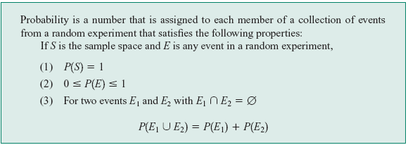
Axioms of Probability

Slide 16
Probability as a Numerical Measure of the Likelihood of Occurrence
Increasing Likelihood of Occurrence
0
.5
1
Probability:
The occurrence of the event is
just as likely as it is unlikely.

Slide 17
THE ADDITION RULE
The probability that event A or B will occur is given by
P (A U B) = P (A) + P (B) – P (A ∩ B ).
If events A and B are mutually exclusive,
then the rule can be simplified to
P (A U B) = P (A) + P (B).

Slide 18
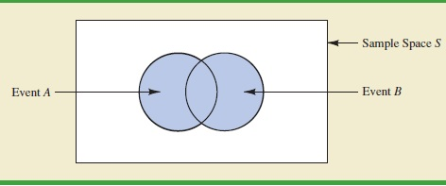

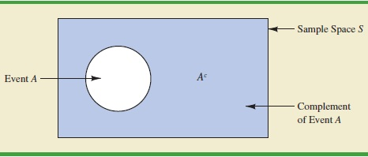

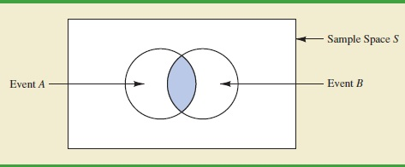
Probability and Venn Diagram

Slide 19
Independent & Dependent
Events are either
Independent (the occurrence of one event has no effect on the probability of occurrence of the other) or
Dependent (the occurrence of one event gives information about the occurrence of the other)

Slide 20
Example
An experiment has the four possible mutually exclusive outcomes A, B, C, D. Check whether the following assignments of probability are permissible:
P(A)= 0.38, P(B) = 0.16, P(C) =0.11, P(D) = 0.35Permissible
P(A)= 0.31, P(B) = 0.27, P(C) =0.28, P(D) = 0.16 NOT
P(A)= 0.32, P(B) = 0.27, P(C) = -0.06, P(D) = 0.47 NOT
P(A)= 1/2, P(B) = 1/4, P(C) = 1/8, P(D) = 1/16 NOT
P(A)= 5/8, P(B) = 1/6, P(C) = 1/3, P(D) = 2/9 NOT

Slide 21
EXAMPLE
If two dice are thrown , what is the probability that the sum is
Greater than 8
Less than 6
Neither 7 nor 11

Slide 22
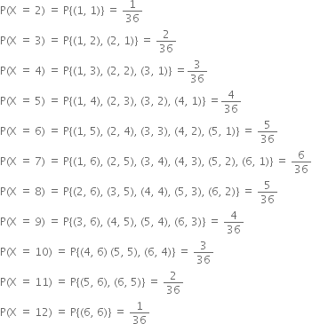
Example

Slide 23
If two dice are thrown , what is the probability that the sum is
Greater than 8
Less than 6
Neither 7 nor 11

Slide 24
If two dice are thrown , what is the probability that the sum is
Greater than 8
Less than 6
Neither 7 nor 11

Slide 25
Example
Consider the following table.
 | Blue | Black | Brown | Total
Software prog | 35 | 25 | 20 | 80
Project Mgrs | 7 | 8 | 5 | 20
Total | 42 | 33 | 25 | 100
If an employee is selected at random , what is the probability that he is a software prog? If an employee is selected at random , what is the probability that he is wearing a blue trouser

Slide 26
Example
A Survey conducted by a bank revealed that 40% of the accounts are savings accounts and 35% of the accounts are current accounts and the balance are loan accounts.
What is the probability that an account taken at random is a loan account ?
What is the probability that an account taken at random is NOT savings account ?
What is the probability that an account taken at random is NOT a current account
What is the probability that an account taken at random is a current account or a loan account?

Slide 27
Example
In a certain residential hub,60% of all households get internet service from the local cable company,80% get the television service from that company, and 50% get both services from that company.
If a household is randomly selected, what is the probability that it gets at least one of these two services from the company, and what is the probability that it gets exactly one of these services from the company?

Slide 28
Example
The sales manager of an e-commerce company says that 80% of those who visit their website for the first time do not buy any mobile. If a new customer visits the website, what is the probability that the customer would buy mobile

Slide 29
EXAMPLE
A speaks truth in 80% cases and B speaks in 60% cases. What percentage of cases are they likely to contradict each other in stating the same fact.

Slide 30
Example
The next generation of miniaturised wireless capsules with active locomotion will require two miniature electric motors to manoeuvre each capsule. Suppose 10 motors have been fabricated but that, in spite of test performed on the individual motors 2 will not operate satisfactorily when placed into capsule, to fabricate a new capsule,2 motors will be randomly selected(that is, each pair of motors has the same chance of being selected ) find the probability that
Both motors will operate satisfactorily in the capsule.
One motor will operate satisfactorily and other will not.

Slide 31
HW problems
Q) Consider randomly selecting a student at a certain university,
and let A denote the event that the selected individual
has a Visa credit card and B be the analogous event for a
MasterCard.
Suppose that P(A)= 0.5, P(A)= 0.4, P (A ∩ B ).
i) Compute the probability that the selected individual has
at least one of the two types of cards (i.e., the probability
of the event ).
ii) What is the probability that the selected individual has
neither type of card?
iii) Describe, in terms of A and B, the event that the selected
student has a Visa card but not a MasterCard, and then
calculate the probability of this event.

Slide 32
Q) In a certain residential suburb, 60% of all households get Internet service from the local cable company, 80% get television service from that company, and 50% get both services from that company.
If a household is randomly selected,
What is the probability that it gets at least one of these two services from the company, and
What is the probability that it gets exactly one of these services from the company?

Slide 33
Q) Suppose that 55% of all adults regularly consume coffee,
45% regularly consume carbonated soda, and 70% regularly
consume at least one of these two products.
i) What is the probability that a randomly selected adult
regularly consumes both coffee and soda?
ii) What is the probability that a randomly selected adult
doesn’t regularly consume at least one of these two
products?

Slide 34
Q) The probability that ‘A’ will be alive 10 years hence is 5/8 and that B will be alive is ¾. Find the probability that
At least one is alive
Exactly one is alive
None are alive

Slide 35
Q) Suppose a student is selected at random from 80 students where
30 are taking mathematics, 20 are taking chemistry and 10 are taking
both. Find the probability ‘p’ that the student is taking Mathematics
or chemistry?.
3) If A and B are events with P(A U B) = 7/8, P(A ∩ B) = ¼ and
P(A') = 5/8, find P(A), P(B) and P(A ∩ B').

Slide 36
Q) The probability that a new airport will get an award for its design is 0.16, the probability that it will get an award for the efficient use of materials is 0.24 and the probability that it will get both award is 0.11
What is probability that it will get at least one of the two awards?
What is probability that it will get only one of the two awards?

Slide 37
Thanks

